Slide 1

TSP Exact
By: Tanner Karol

Slide 2
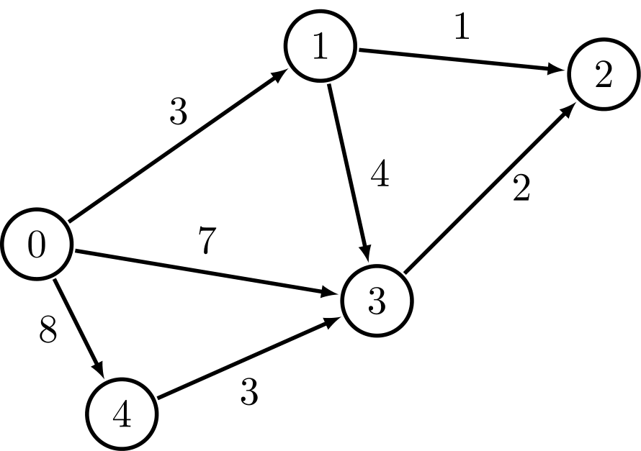
What Is TSP?
In short the traveling salesman problem where a “salesman” needs to visit the full set of “cities” (nodes) exactly once, starting and ending at the same city (node).
The goal of this problem is to minimize the total distance.
Decision problem: “Is there a route that visits all cities and has a total distance ≤ K?
Optimization Problem: “What is the shortest possible route that visits all nodes?”

Slide 3
Benchmarks for TSP Exact Solution
The brute-force approach is effective for smaller graphs but quickly becomes impractical as the number of vertices increases, due to exponential growth in the number of possible routes.
Test Case | Number of Vertices | Exact Cost | Exact Runtime (s)
testCase3 | 5 | 155.0 | 0.00006
testCase4 | 8 | 307.7 | 0.0065
testCase5 | 10 | 275.5 | 0.36
testCase6 | 25 | Not Computed | Not Computed
testCase7 | 50 | Not Computed | Not Computed

Slide 4
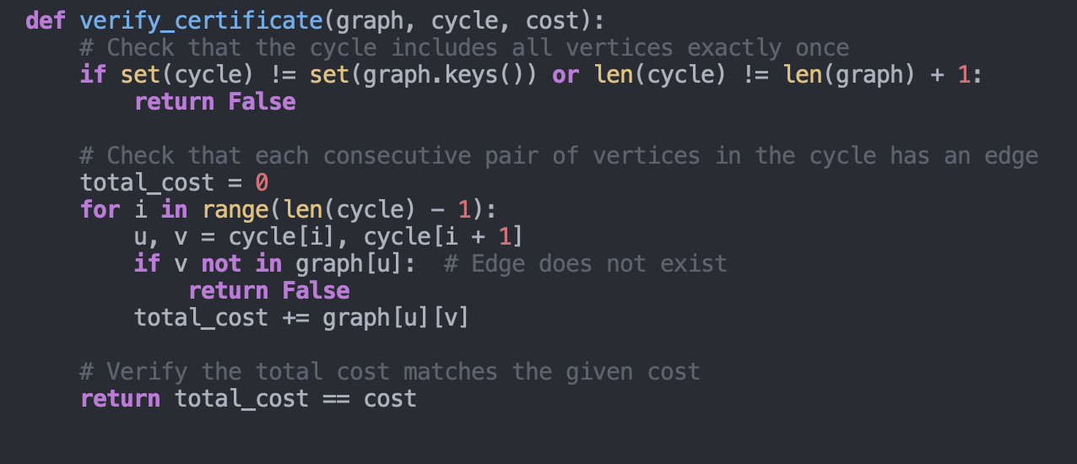
Verifying the Certificate for TSP
What is a certificate?
A list of vertices representing a Hamiltonian cycle.
The total cost of the cycle.
What does the certifier do?
Checks that all vertices are visited exactly once.
Verifies that edges exist between consecutive vertices in the cycle.
Ensures the total cost matches the given value.
Why is it polynomial?
Each check takes O(n), where n is the number of vertices.
The process grows linearly with the size of the input.

Slide 5
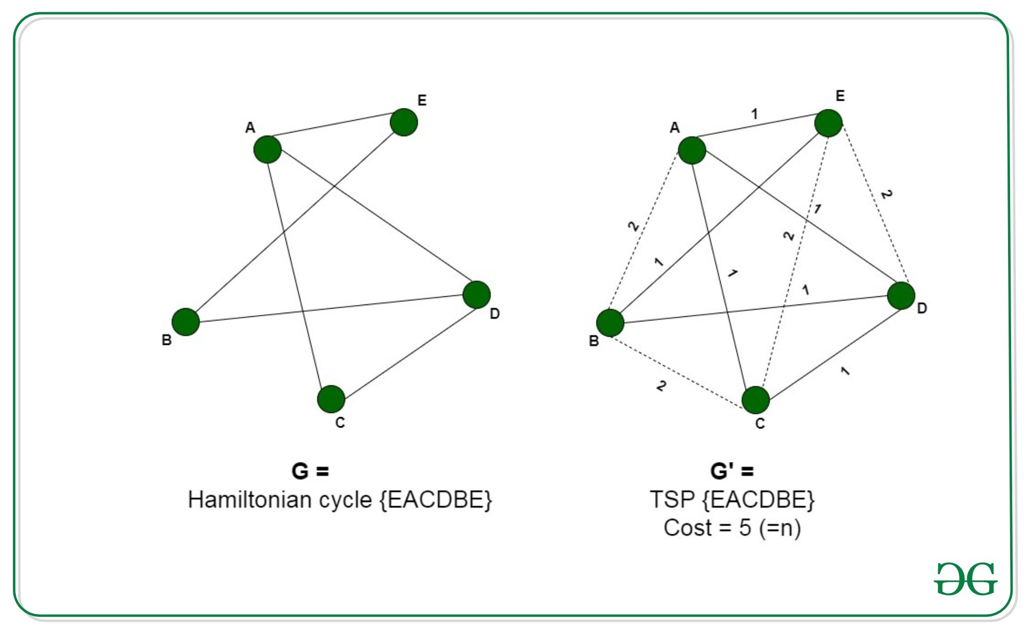
Reduction from Hamiltonian Cycle to TSP
Pre-requisite:
The TSP requires finding the shortest path that visits every vertex exactly once and returns to the starting point.
The Hamiltonian Cycle problem checks if a cycle exists that visits every vertex exactly once without considering weights.
Reduction Steps:
Input for Hamiltonian Cycle:
Graph G = (V, E), where V are vertices and E are edges.
Constructing Graph G′ for TSP:
Retain edges of G with a cost of 1.
Add all missing edges to make G complete, assigning them a cost of 2.
Set the maximum cost K=N where N is the number of vertices.
Verify:
If the TSP solution for G′ has a cost K=N, the original graph G contains a Hamiltonian Cycle.

Slide 6
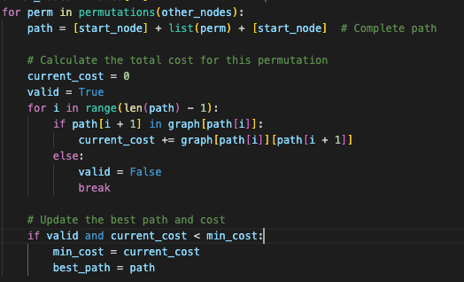
Analytical Runtime Analyis
The runtime of my exact TSP solution is O(n⋅n!).
Why?
Generating all permutations of n-1 nodes takes (n-1)! Time.
For each permutation, computing the total cost of the cycle takes O(n).
This gives a total complexity of O(n⋅n!).
Dominant Portion of the code.

Slide 7
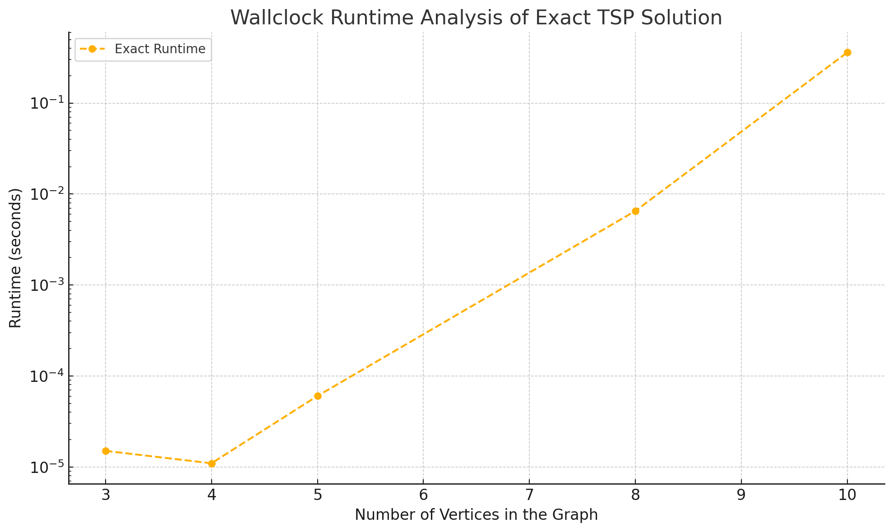

Slide 8
CS412 TSP Project
Parts C & D Thomas Brickhouse

Slide 9
Pseudocode & Strategy Discussion
one_tsp(graph):
Randomly choose a starting node
While there are unvisited nodes
Find the closest node
Update current path and cost
Return current path and cost
tsp_approx(graph):
While time < total time
Call one_tsp(graph)
If current_cost < best_cost
Update best path and cost
Randomly choose a node to start at
Perform a greedy traversal of the graph
If the cost of the path is the lowest seen, store it as he new optimal path
Repeat until time runs out

Slide 10
Analytical Runtime Analysis
The analytical runtime of my approximate TSP solution is Ο(𝑘 • V²)
The function one_tsp(graph) has a runtime of Ο(V²)
The function tsp_approx(graph) makes a call to one_tsp(graph), 𝑘 times, where 𝑘 is the total number of runs that fit into a given timeout

Slide 11
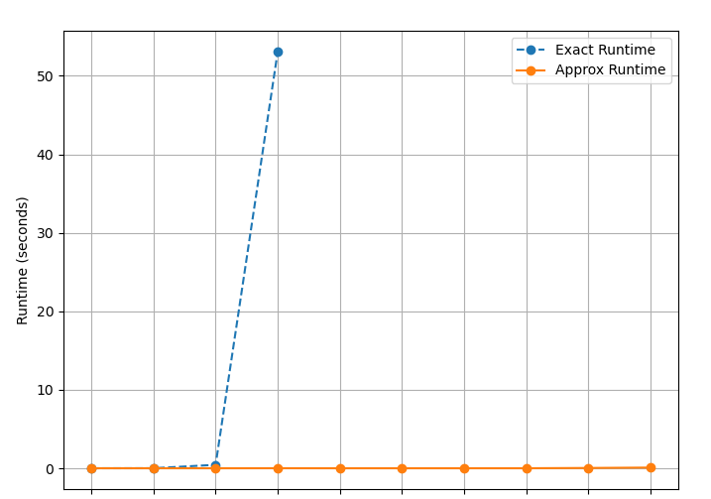
Performance Comparison
3 8 10 12 15 18 20 100 500 1000
Number of vertices in the graph
Notes:
Plots that illustrate the run-time (wall clock) performance of your exact solution versus the approximation solution on your test cases

Slide 12
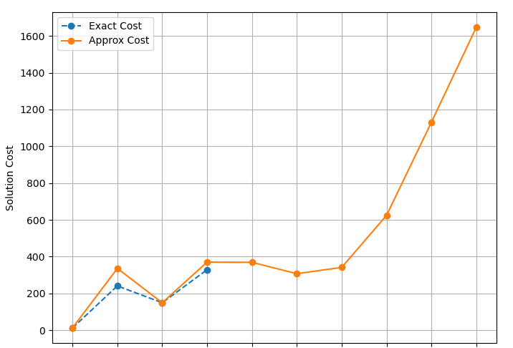
Result Comparison
3 8 10 12 15 18 20 100 500 1000
Number of vertices in the graph
Notes:
plots that compare the result/solution of your exact solution versus the approximation on your test cases. This is where you show the value achieved by both and see how well your approximation did versus the optimal solution.

Slide 13
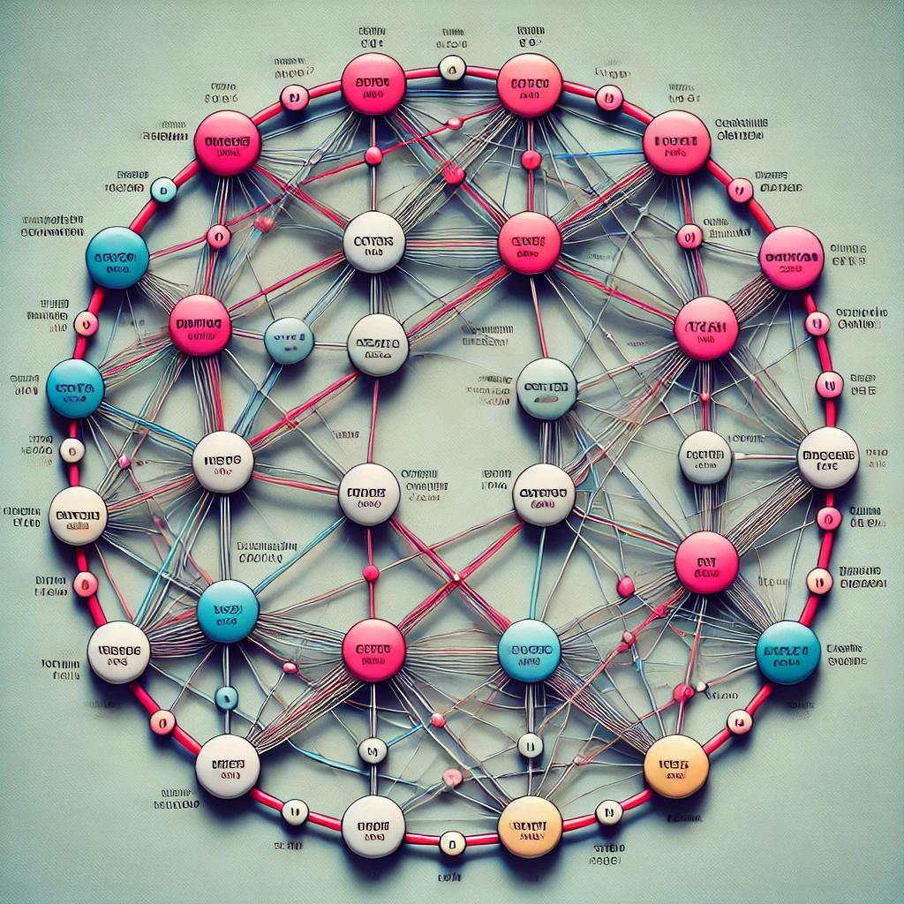
TSP Augmentation
12/9/2024
By: Luke Hennessy

Slide 14
12/9/2024
Minimum Spanning Tree (MST)
Minimum Spanning Tree of a weighted, undirected graph
1
1
2
2
10
3
3
2
3
2
3

Slide 15
12/9/2024
Estimating a Lower Bound
MST as Lower Bound for TSP: MST connects all vertices with the minimum cost and no cycles, while the TSP requires additional constraints like visiting each vertex once and returning to the start.
TSP Cost ≥ MST Cost: The TSP cost is at least as large as the MST cost because it must form a Hamiltonian cycle, which adds extra cost.
Approximation of TSP Return Cost: Adding the least cost edge not in the MST approximates the additional cost of returning to the starting point in the TSP.

Slide 16
12/9/2024
Augment Runtime
Graph Characteristics:
V: Number of vertices
E: Number of edges
Steps and Complexities:
Calculate MST using Prim's Algorithm: O(E log ⁡V)
Extract MST edges: O(V)
Find lightest non-MST edge: O(E)
Key Insight:
Prim's Algorithm dominates the runtime, making the overall complexity: O(E log⁡ V) which is polynomial time computable.

Slide 17
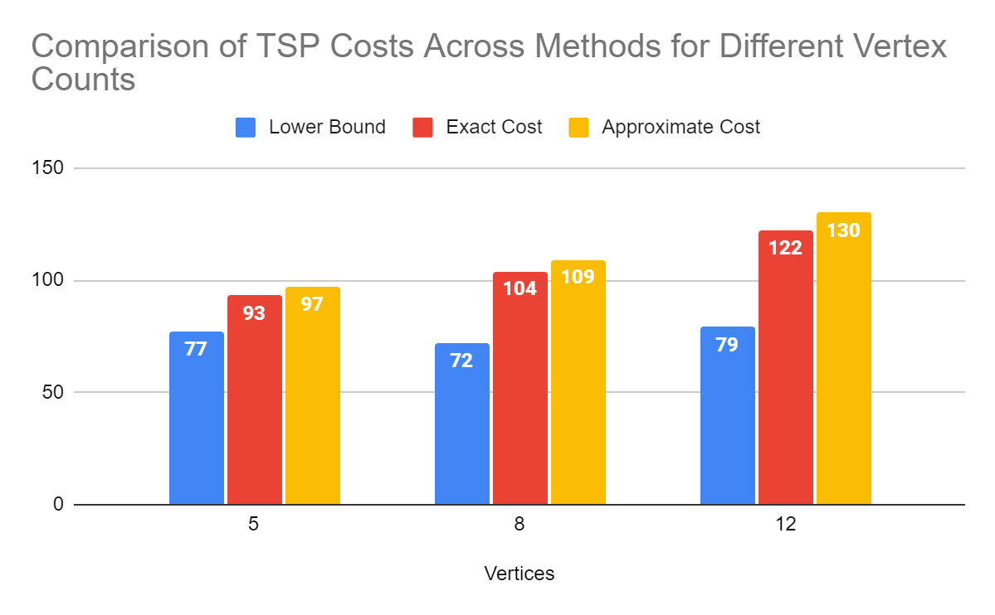
Cost Comparison
Comparative Analysis (Bar Chart)
12/9/2024
Graphs computed with random edge weights in range 1 - 50
Costs shown are averages from 10 runs with the same vertex count, rounded to whole numbers

Slide 18
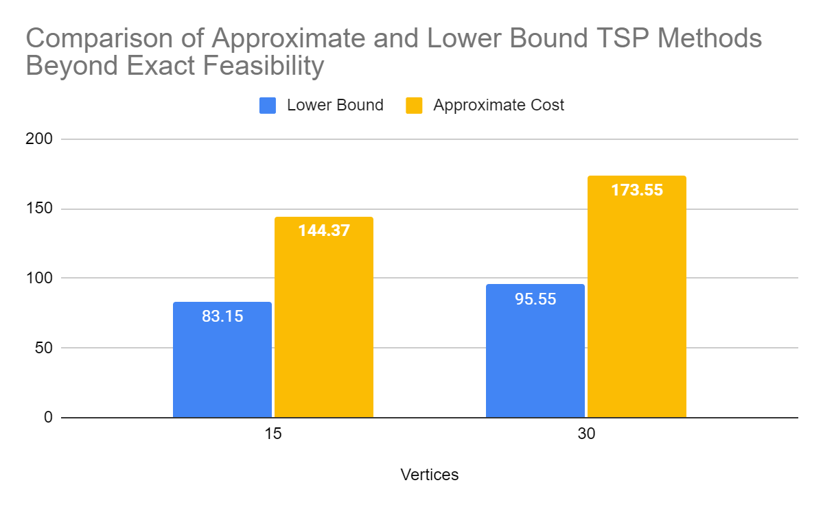
Cost Comparison
Comparative Analysis (Bar Chart)
12/9/2024
Exact Solution runtime > 12 hrs at 15 nodes *Estimation*
Graphs computed with random edge weights in range 1 - 50
Costs shown are averages from 10 runs with the same vertex count

